Slide 1
CSCNSI 2015
Networking Concepts

Slide 2
Introduction
Cluster Networking
Network Security
Security Log Monitoring

Slide 3
Cluster Networking

Slide 4
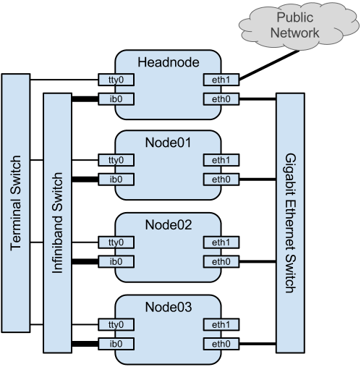
Cluster Networking
Public access is solely through a single port on the cluster head-node
Head-node is publicly accessible; needs security!
Acts as router for internal network
Authentication / authorization at that port

Slide 5
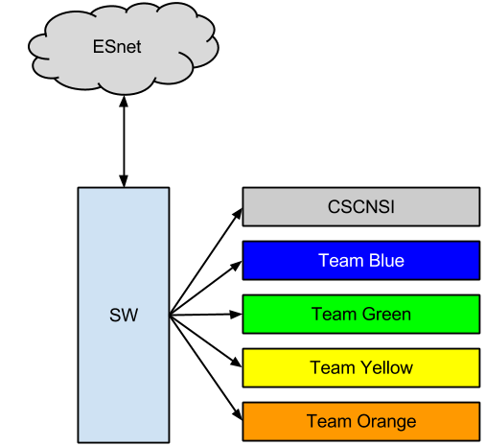
Our Setup
Internet
Cerulean
Vermilion
Celadon
Saffron

Slide 6
Cluster Networking

Slide 7
Cluster Networking
We pay for bandwidth
try to minimize it
Professional use only
Download locally if possible
CSCNSI repositories
If you need something large, ASK!
Cache locally if you need multiple copies
Limit your download rates

Slide 8
Network Security

Slide 9

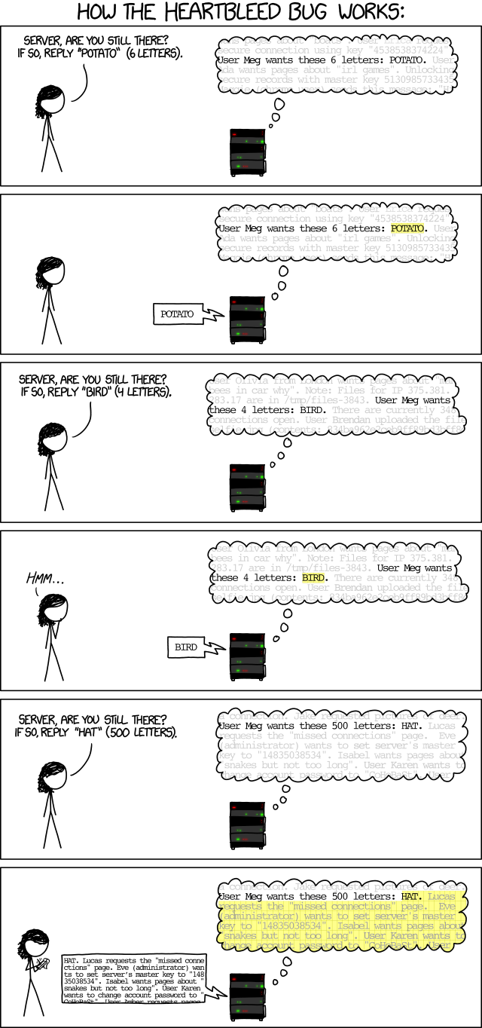
OpenSSL Heartbleed Explained

Slide 10
Network Security
Heartbleed was in the wild for six months before its discovery and disclosure!
“Testing shows the presence, not the absence of bugs” -Dijkstra
What can be done to mitigate security risks?

Slide 11
Network Security
Vulnerabilities
Bugs in accessible services
Keep your OS updated!
Only run what you need
Only make accessible what you need; only to who needs it
Misconfigured accessible services
Read system logs
List open (listening) ports: /bin/netstat -a

Slide 12
Network Security
Firewalls (iptables)
Rule-based
Incoming and outgoing connections
Lots of filter types (IP address; hostname; port; traffic type; protocol; …)
Prefered method:
Block everything
Only open necessary ports
But only to necessary clients

Slide 13
Network Security
Port Numbers
What port number is associated with a service?
grep through /etc/services to find associated port numbers
Just use the name in iptables
Sometimes you have to Google it if there are several ports and varying (non-intuitive) names!

Slide 14
Network Security
IP Geolocation
IP addresses are located to regions
What countries are you servicing?
There are blacklists of IP addresses too
For long lists, use ipset with iptables
I block all non US addresses
http://www.ipdeny.com

Slide 15
Network Security
Other Methods
Turn off / uninstall unnecessary services!
TCP Wrappers
/etc/hosts.allow; /etc/hosts.deny
Only works with some services (sshd)
Same method as iptables

Slide 16
Security Log Monitoring

Slide 17
Log Monitoring
Manually
Schedule time to comb through and look for anomalies
Do it on a regular basis
One good indicator is a sudden large size increase in a log file

Slide 18
Log Monitoring
Automated
logwatch
email notification on pattern matches
fail2ban
Programmable filters
Usually pattern matches in log file

Slide 19
Summary

Slide 20
Summary
Cluster Networking
Network Security
Security Log Monitoring

